Slide 1
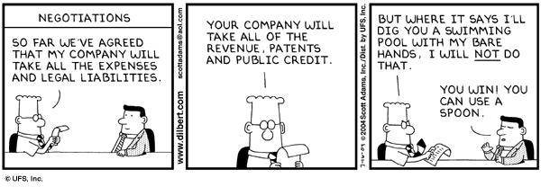


A Short Presentation on Negotiation
Danny Mulligan
Lisa Novak
10/10/12

Slide 2
Negotiation Matters!
3 big negotiations most people do
Car, House, Job
Negotiation is about more than just money
Some other important negotiations…
Personal relationships
Politics
Expectation management
Being a good negotiator is personally empowering
Negotiation is a HUGE subject, I’m still a student

Slide 3
How to become a better negotiator
Educate yourself
Classes, podcasts, audiobooks, books, Wikipedia
Negotiation is a people skill, not a contact sport
Read about it
Many, many good books, 2 suggestions on next slide
Practice makes perfect
Buy and sell stuff on craigslist, eBay, market
Haggle with your plumber, mechanic, dentist
Sit in on negotiations at work
Don’t do it alone
Talk over a big negotiation with your friends/family
Get someone else to help, hire a professional if necessary
Don’t be afraid to take a break, don’t be afraid to ask for more

Slide 4

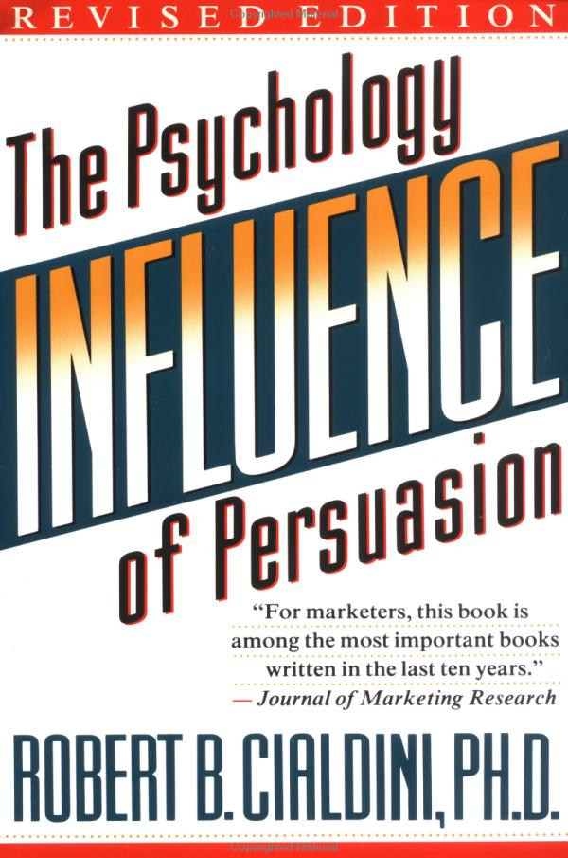

3 great books on negotiation
Mechanics
Psychology
Relationships

Slide 5




Examples of negotiation in the movies (not necessarily realistic)

Slide 6


Negotiation = poker or chess?

Slide 7


Negotiation = competition or cooperation?

Slide 8
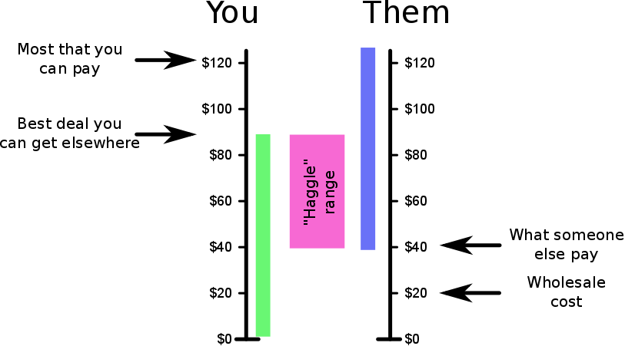
Available negotiation room

Slide 9
You’re in a big negotiation, so what do you do?
Understand what the other side wants
Understand what you want
Look for win-win agreements
Negotiate on your terms - Verbal or written? Fast or slow? Their place, yours, or neutral?
Create competition (AKA: BATNAs), be able to walk away if necessary, take breaks if you want
Form a personal relationship with the other side
Bluffing, lying, manipulation, trickery = not necessary. Don’t tolerate it from the other side

Slide 10
New job negotiation
Be NICE & be upbeat! You want them to be as excited about hiring you as you are about going to work with them.
Understand the total package – salary, benefits, options, other benefits
Understand your value to the employer
Don’t be afraid to ask how they came up with the offer. Don’t be afraid to ask for more. :-)
Recruiters: They can be useful, but be careful. Never pay them! Don’t use just one. Track what they are doing. It’s OK to follow up with the company.

Slide 11
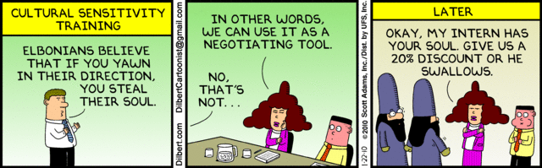
References
Books
Getting to YES - Roger Fisher, William Ury, & Bruce Patton
Influence: The Psychology of Persuasion - Robert Cialdini
How to Win Friends & Influence People - Dale Carnegie
High Stakes, No Prisoners - Charles Ferguson
Online
How to buy a car - https://www.youtube.com/watch?v=pPor5b7JLLE
Wikipedia on negotiation - https://en.wikipedia.org/wiki/Negotiation
Article summary of the Cialdini book - http://uspace.shef.ac.uk/servlet/JiveServlet/previewBody/61756-102-1-117566/HarnessingTheScienceofPersuasion.pdf

